Slide 1
Graph Theory

Slide 2
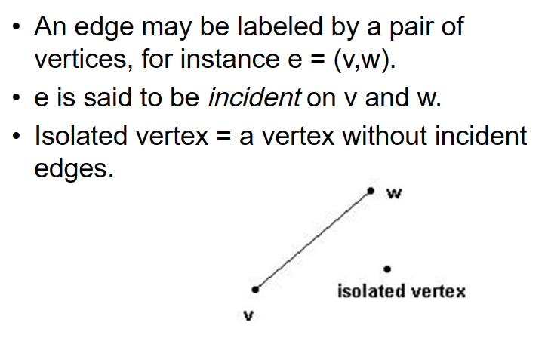
Edges

Slide 3
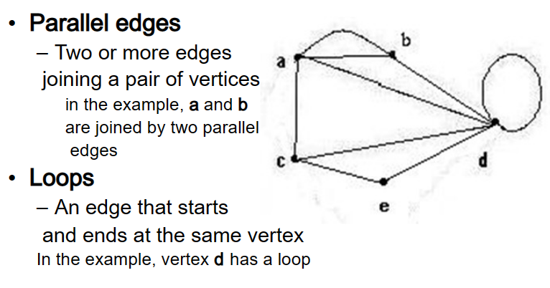
Special Edges

Slide 4
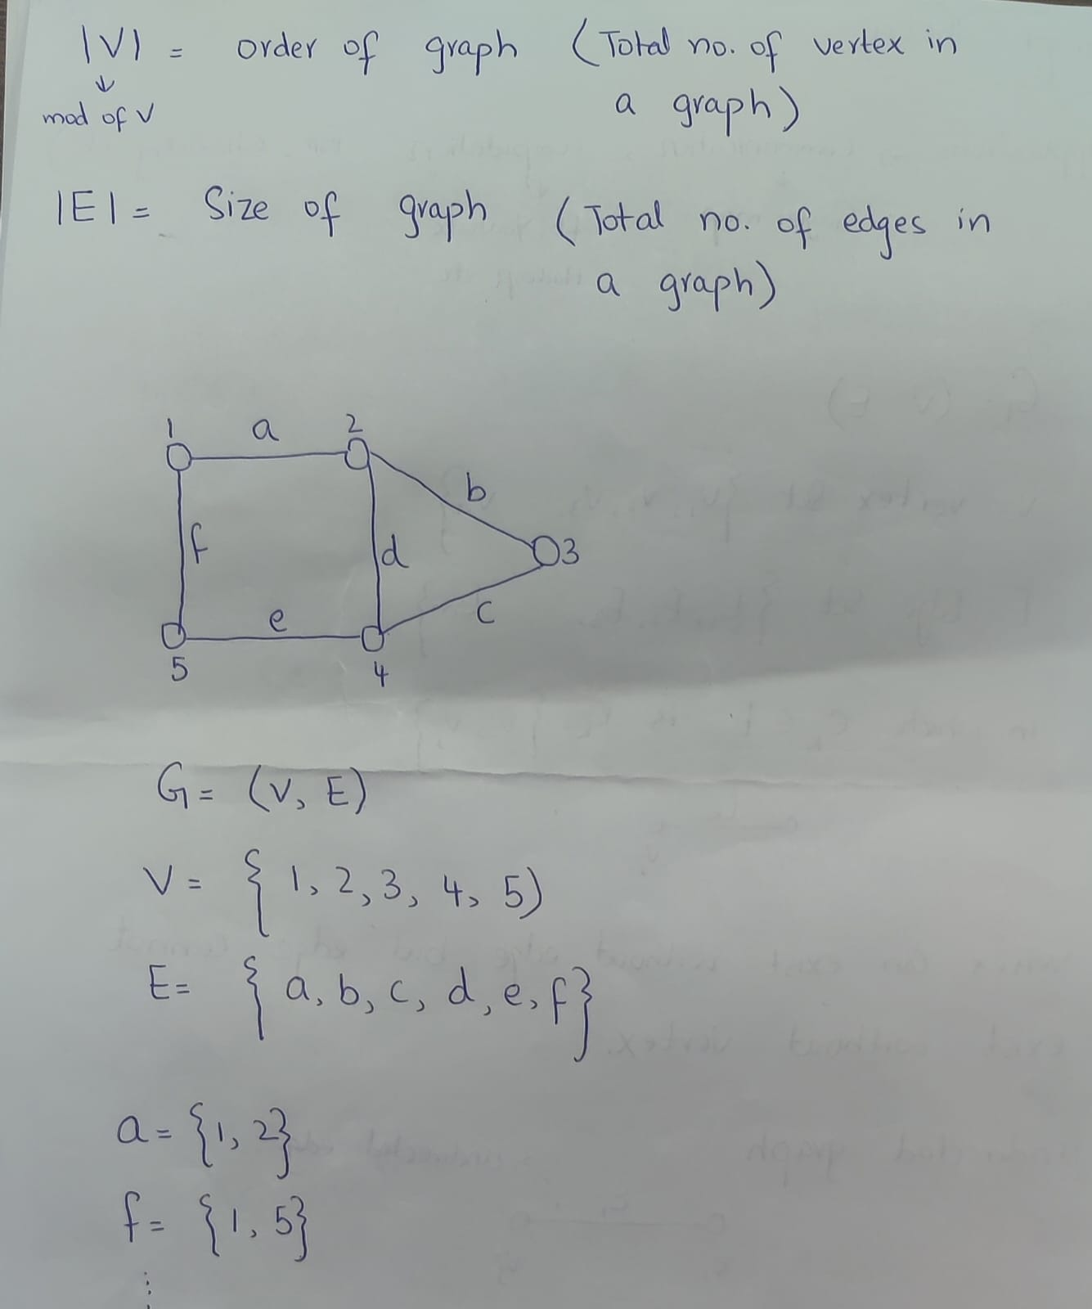

Slide 5
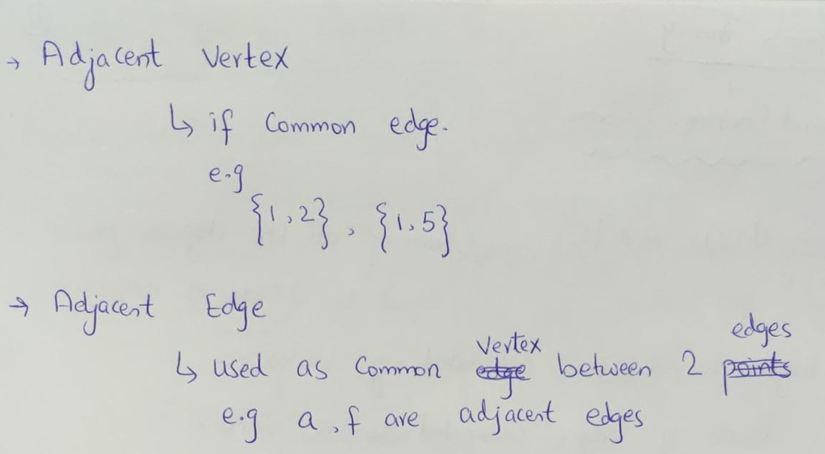

Slide 6
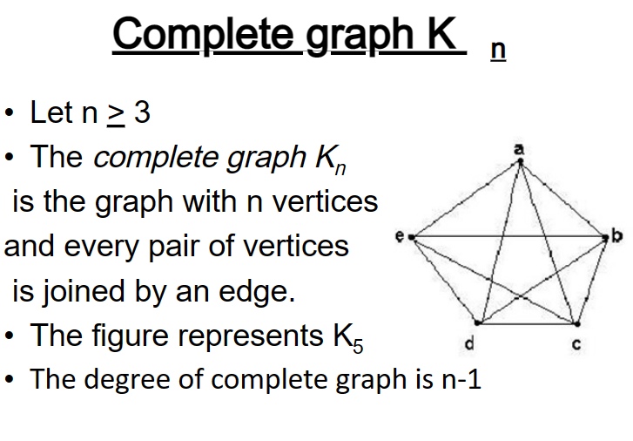

Slide 7
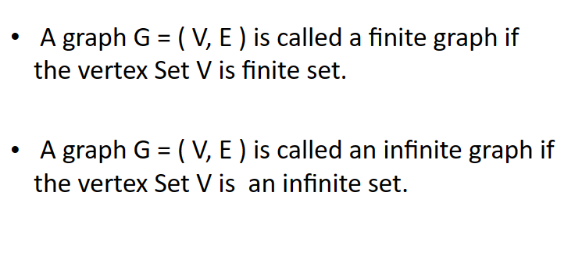
Finite and Infinite Graph

Slide 8
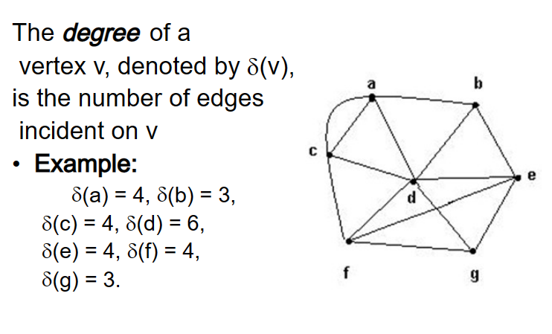
Degree of the Vertex

Slide 9
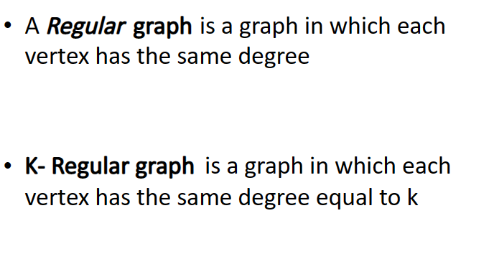
Definition

Slide 10
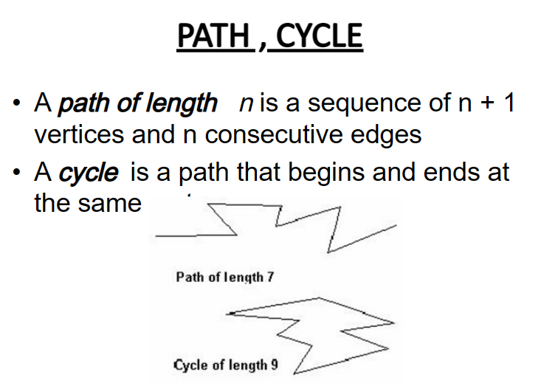

Slide 11
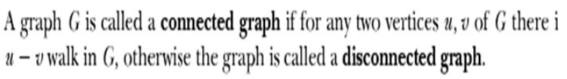
Connected and Disconnected Graph

Slide 12
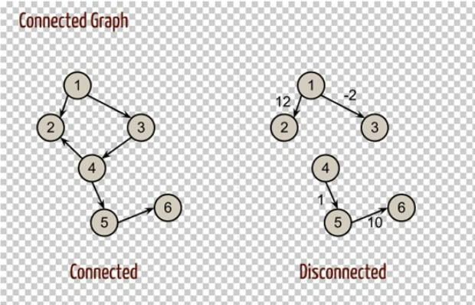

Slide 13
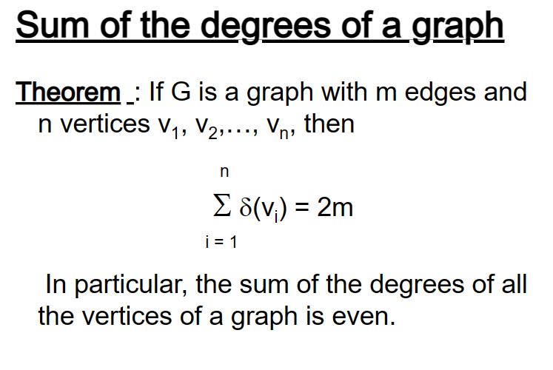

Slide 14
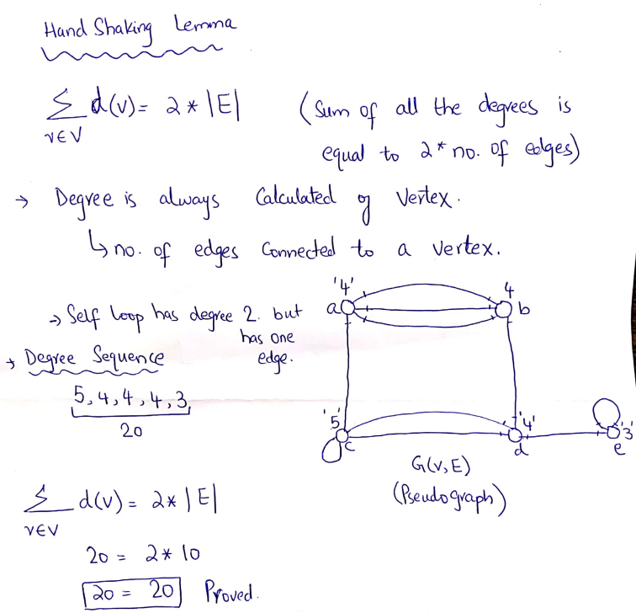
Handshaking Lemma

Slide 15
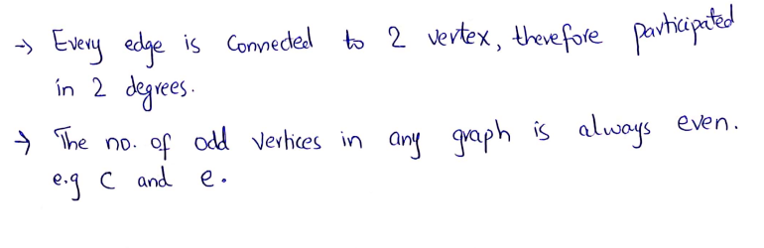

Slide 16
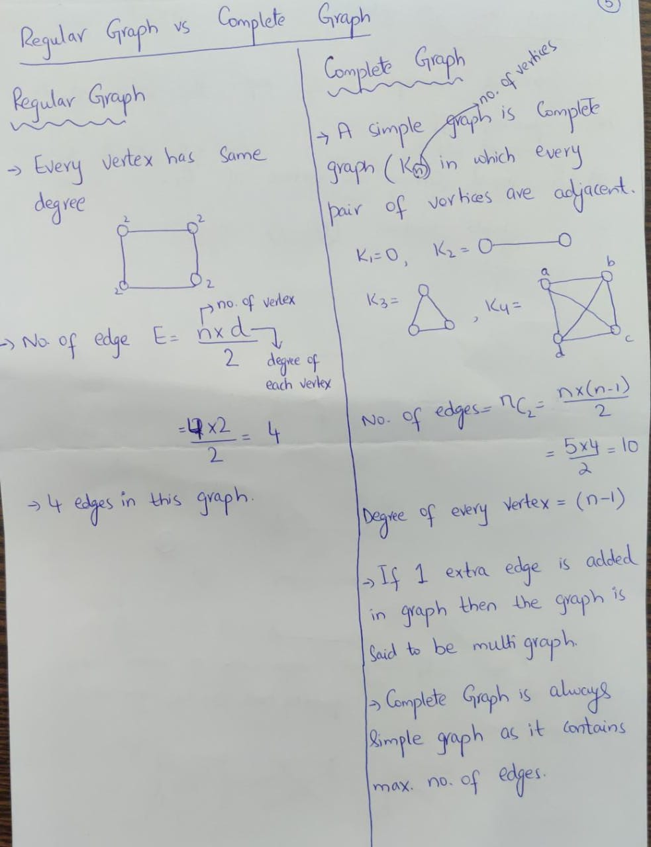
Regular vs Complete Graph

Slide 17
Greedy Algorithms

Slide 18
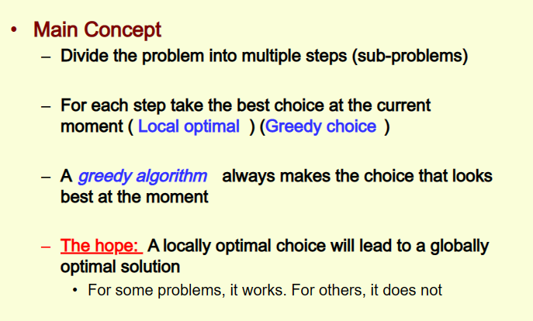
Greedy Algorithms

Slide 19
Applications of Greedy Strategy
Minimum Spanning Tree
Scheduling Problems
Huffman codes
Traveling salesman Problem
etc

Slide 20
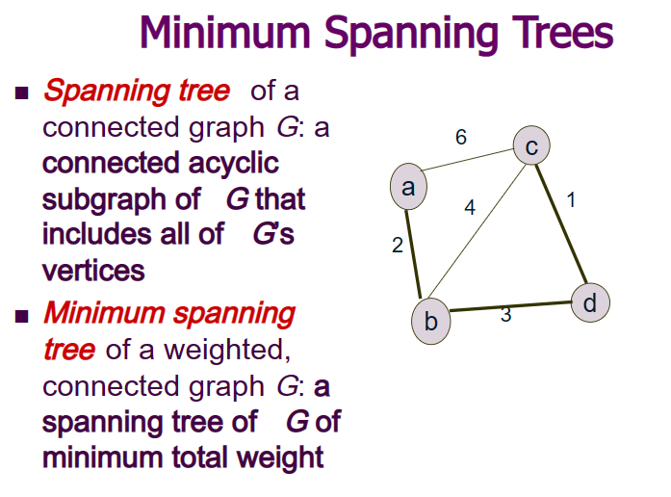

Slide 21
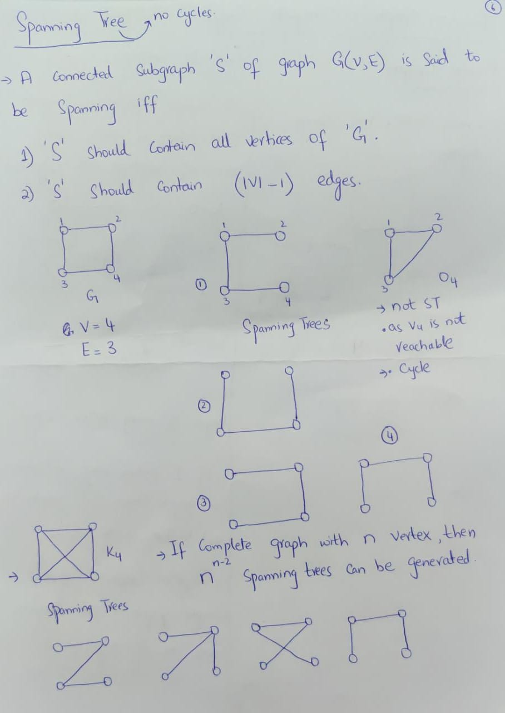
Spanning Tree

Slide 22
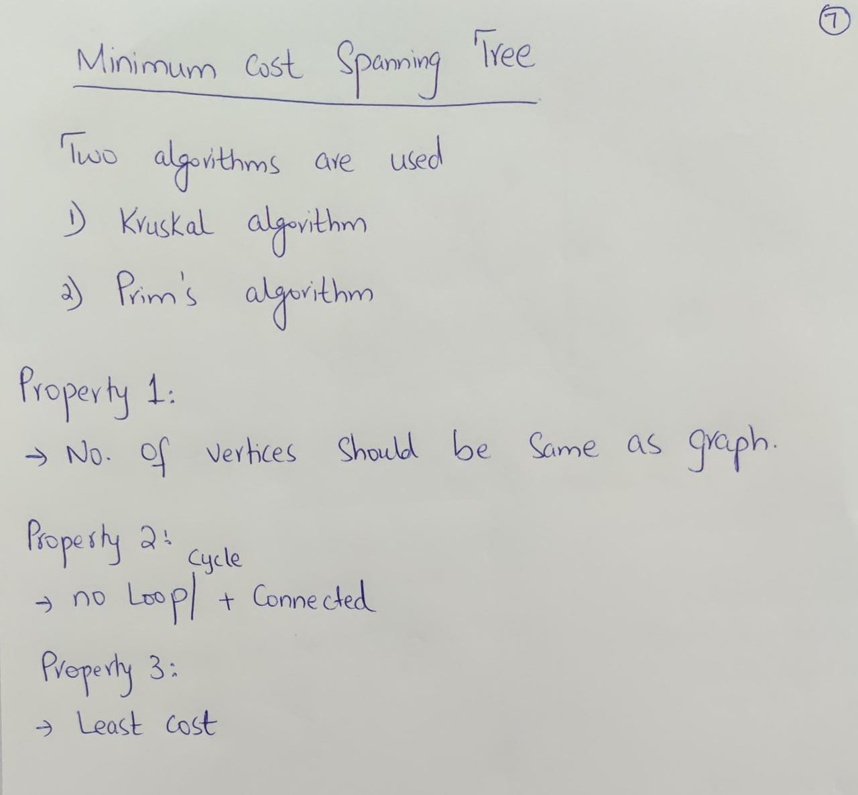

Slide 23
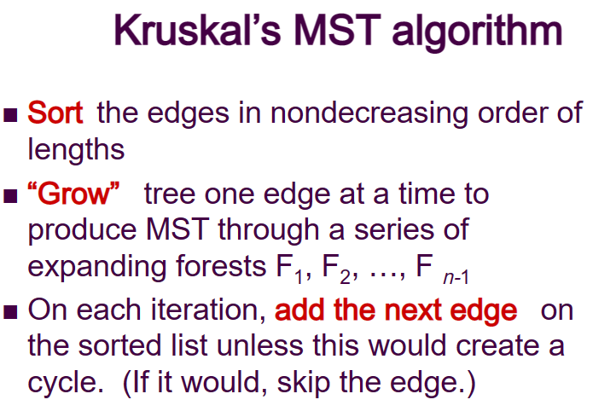

Slide 24
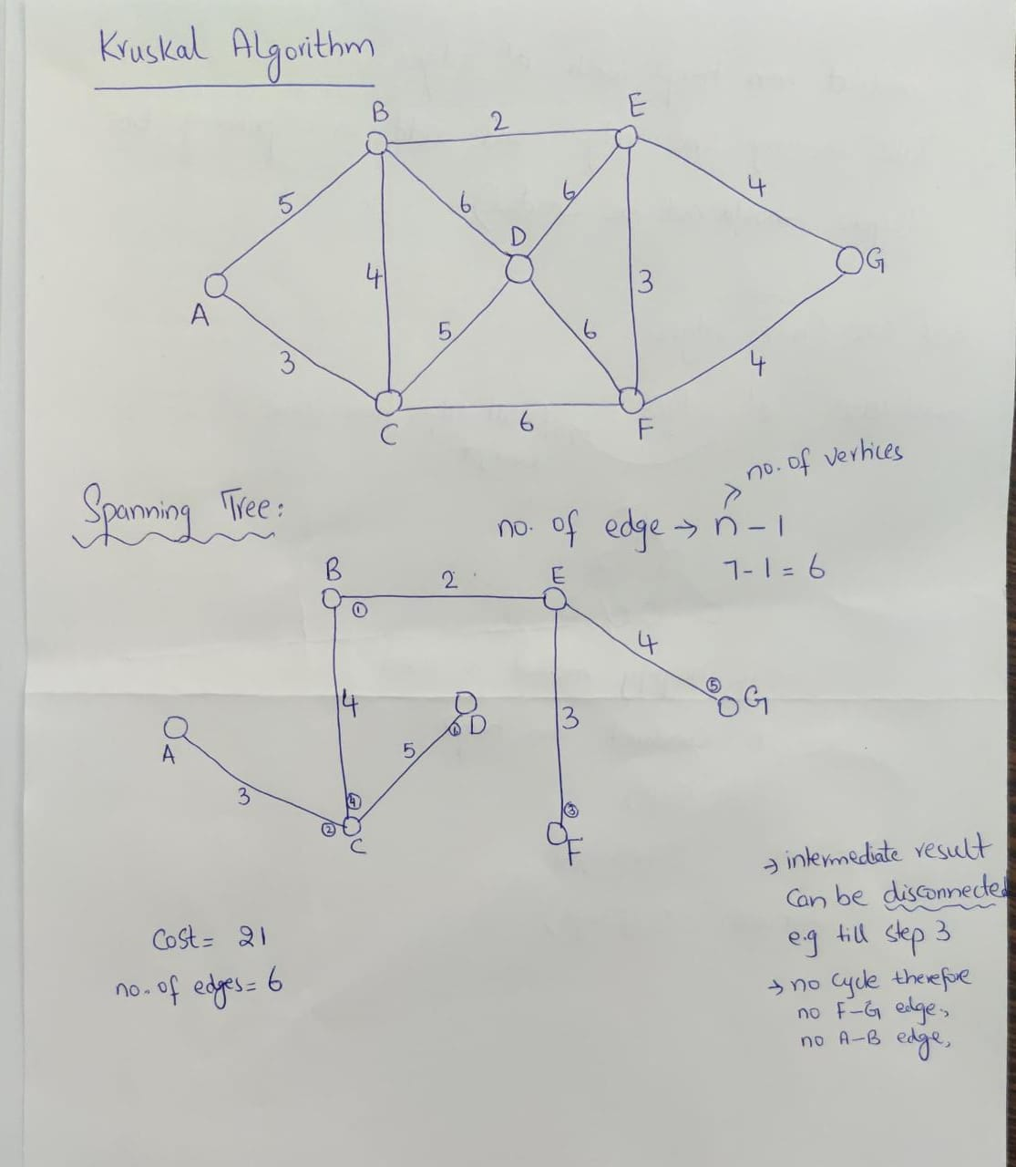
Kruskal Algorithm

Slide 25
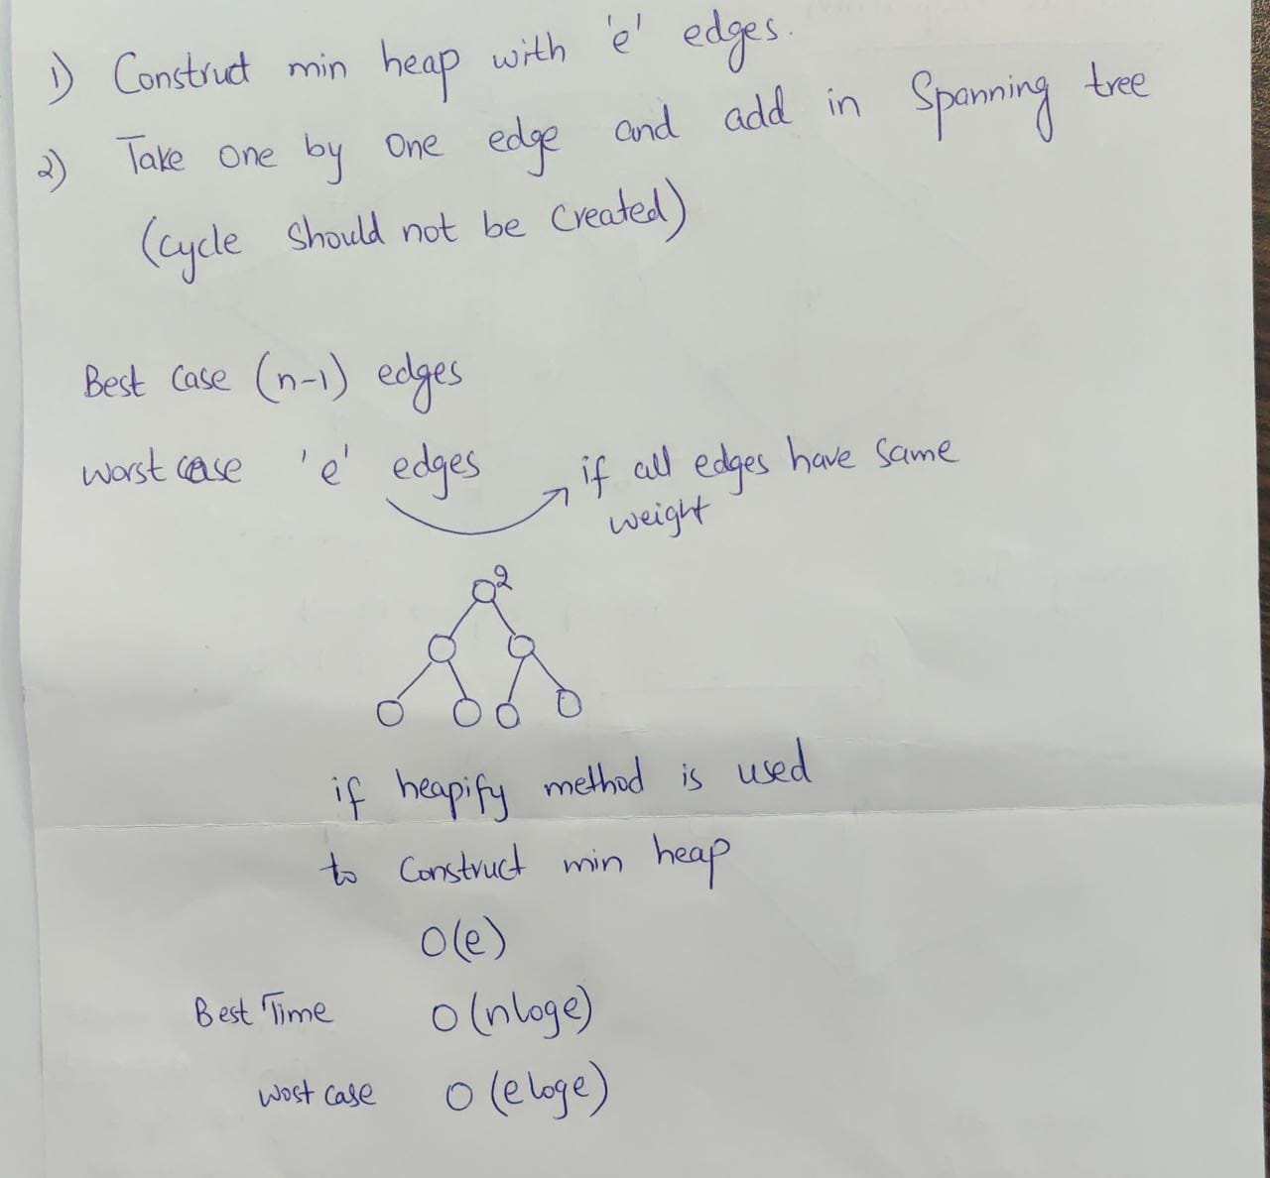

Slide 26
Graph Traversal

Slide 27
Graph Traversal
The process of visiting and exploring a graph for processing is called graph traversal.
Breadth First Search (BFS)
Depth First Search (DFS)

Slide 28
BFS & DFS
Order of nodes traversal is different
BFS: Traverse level wise
DFS: Traverse depth wise

Slide 29
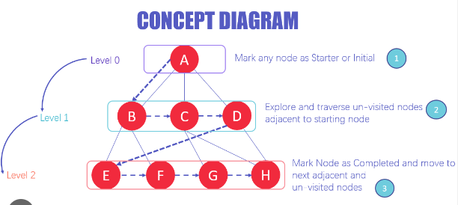
BFS Example

Slide 30
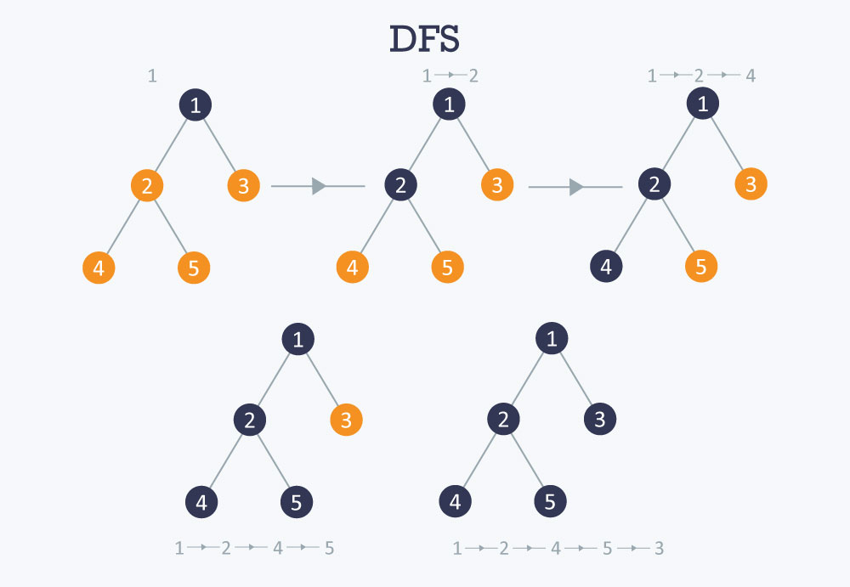
DFS Example

